Slide 1
The Last Survivor
By Anas Hussain

Slide 2
Game World
Post Apocalyptic World
Starts off with a scene that shows world destruction due to an asteroid impact
The asteroid is actually an alien spaceship, here to take over the world
We are the last survivor
With limited resources, we have to disable the main spaceship to save the world from the cybernetic virus

Slide 3
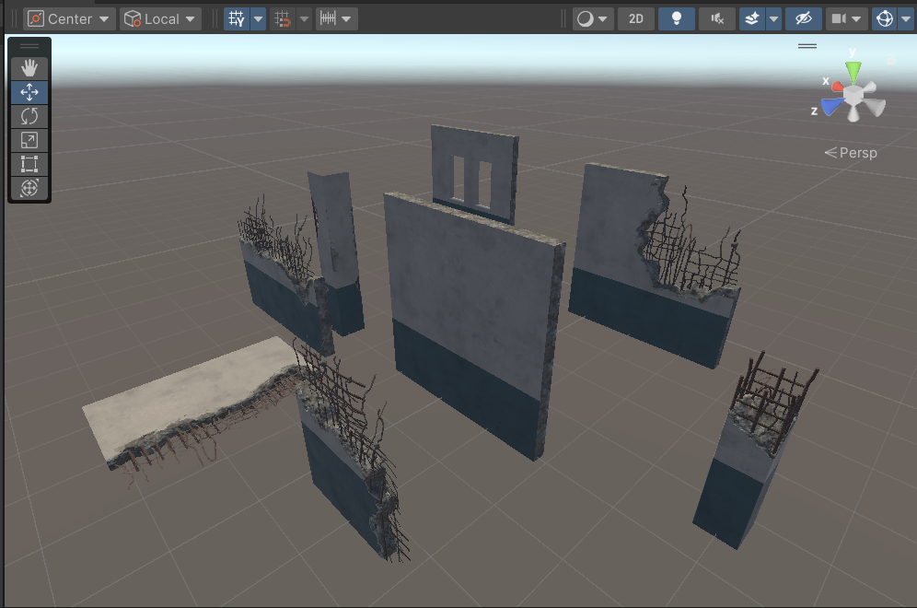
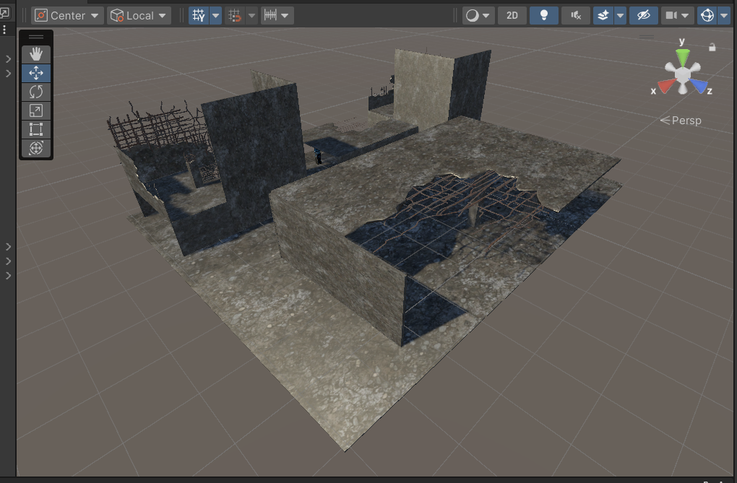
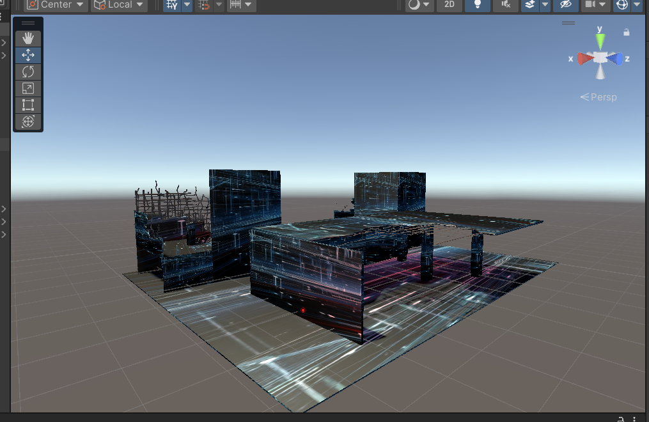
Building Creation
Used Pre-Built elements
To Make building blocks
Applied Texture for the cyber theme

Slide 4
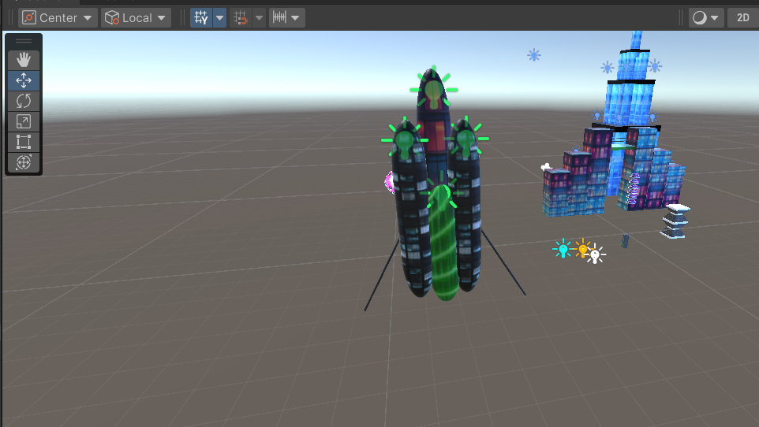
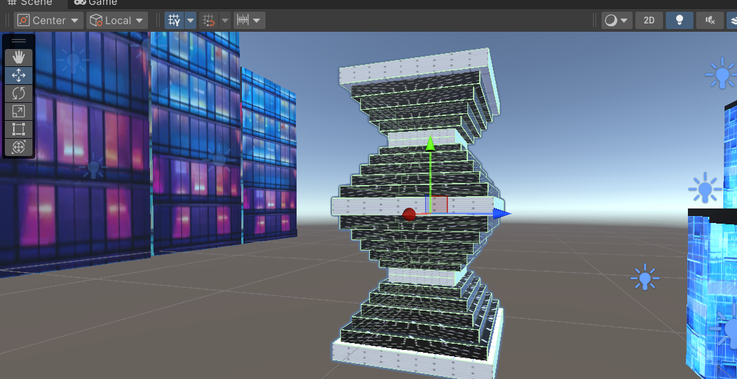
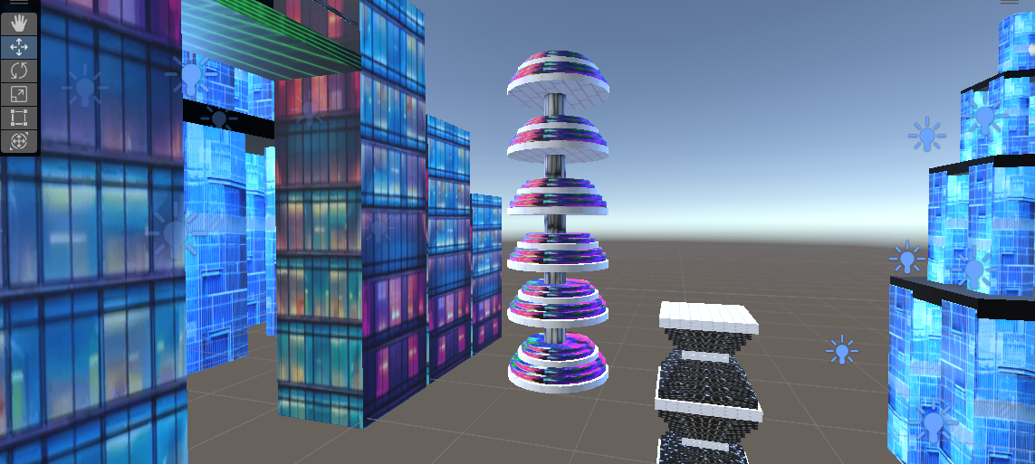
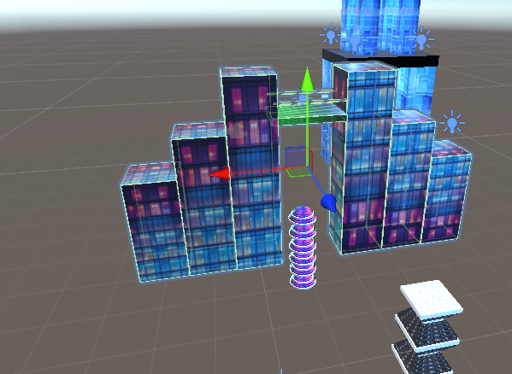
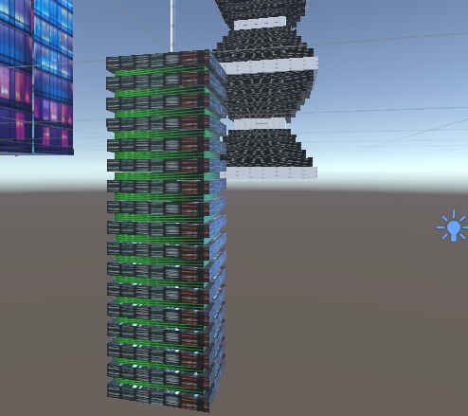
Some Custom Made Buildings

Slide 5
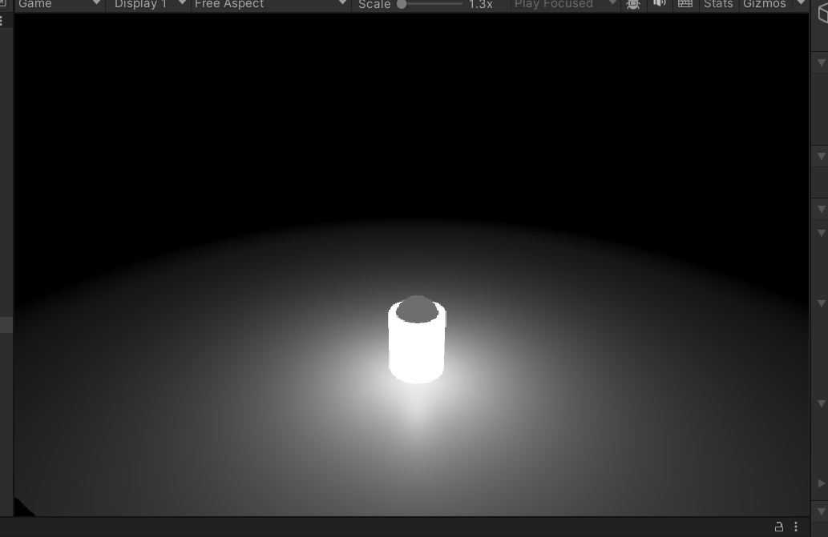
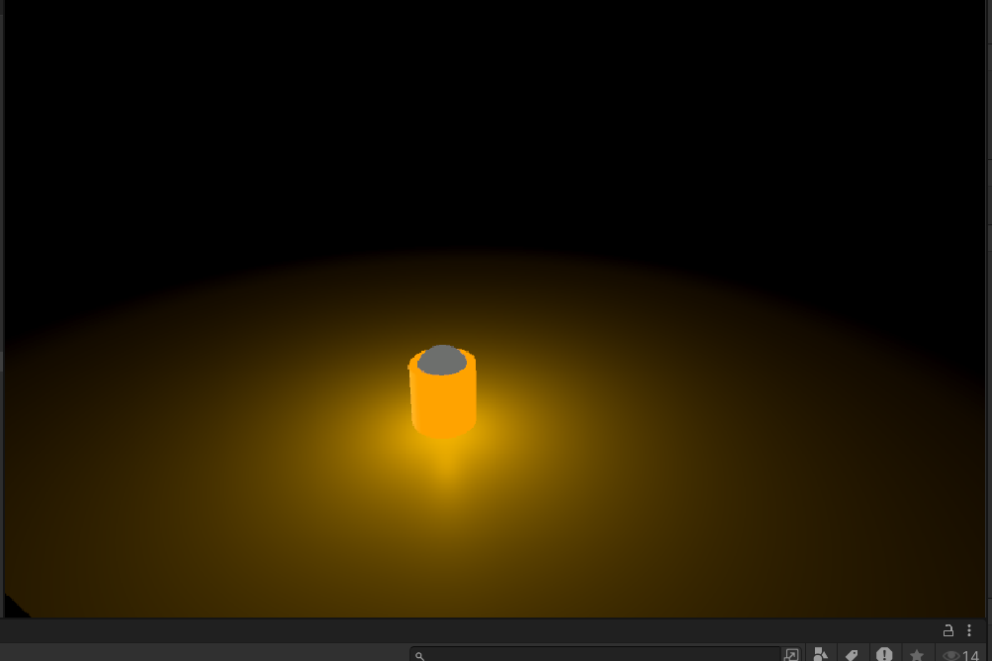
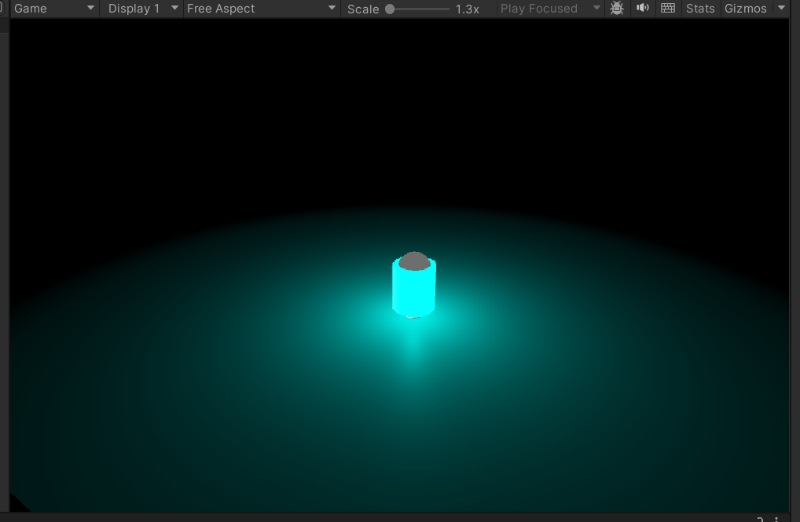
Custom Packages
Oxygen Package
Collect by killing Aliens or by restoring buildings
Sunlight Package
Collect by killing Aliens or by restoring buildings
Water Package
Collect by killing Aliens or by restoring buildings

Slide 6
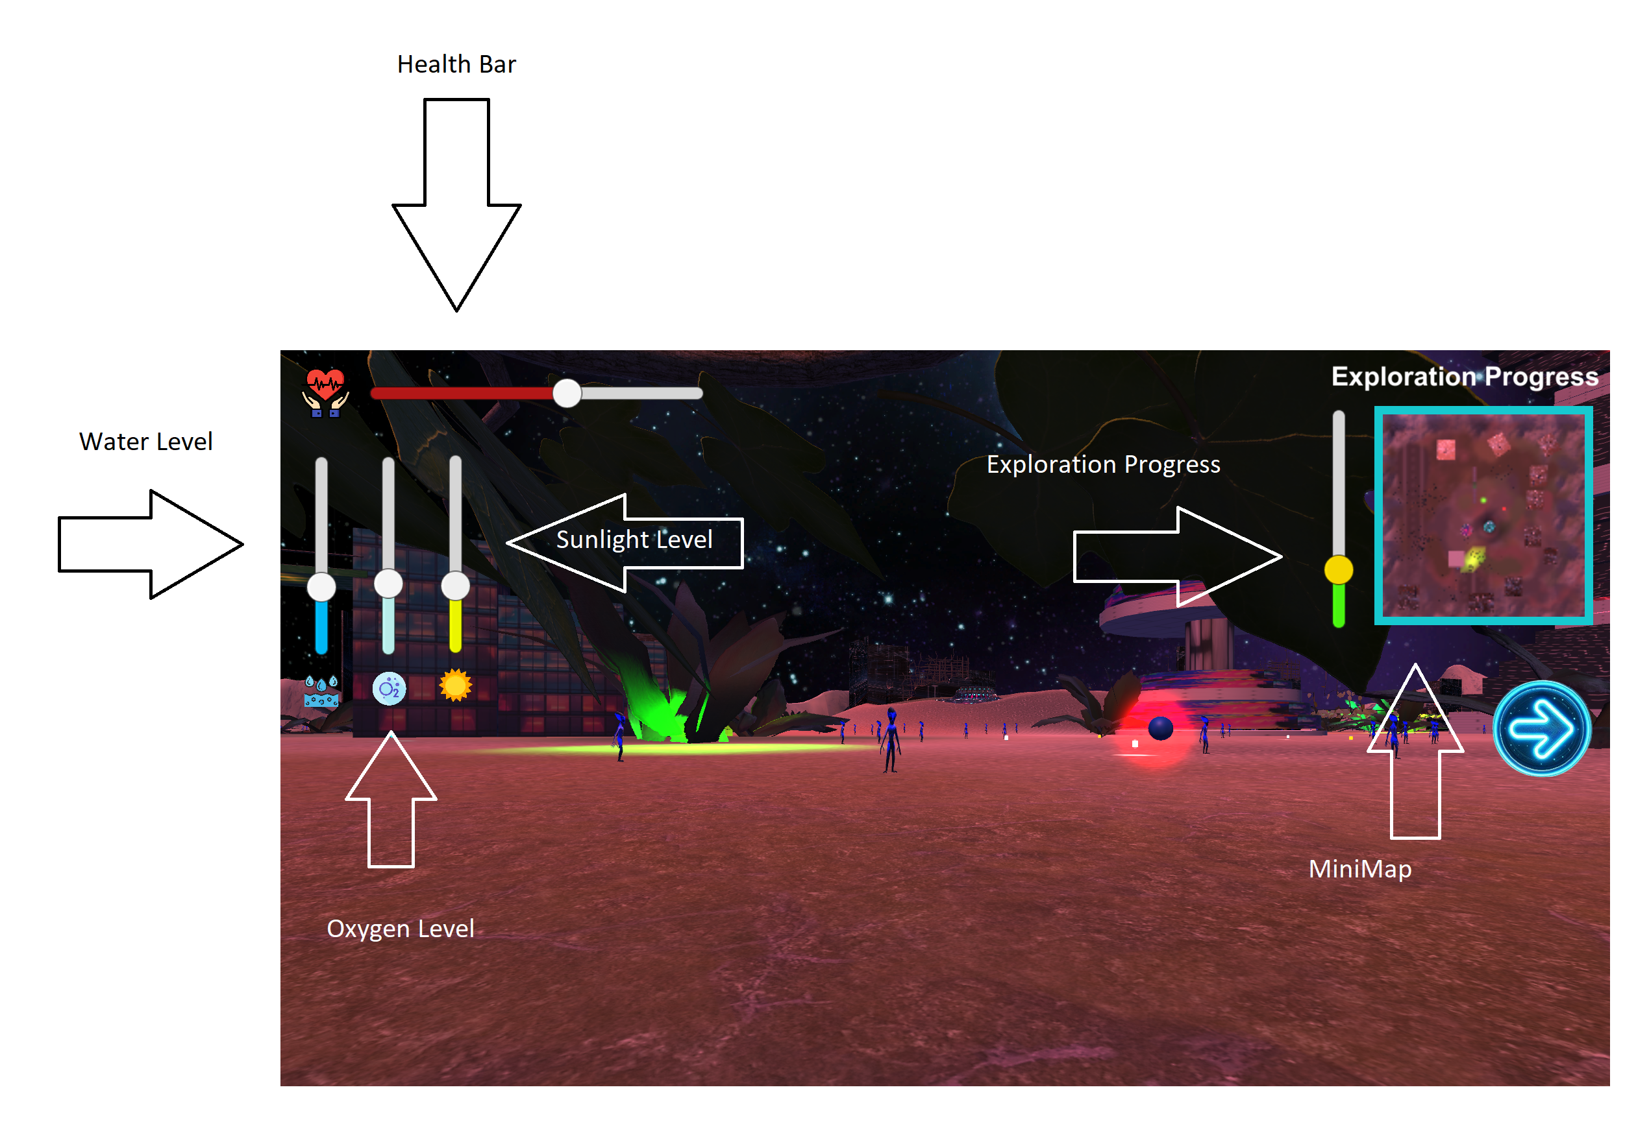
HUD

Slide 7
Controls
Use mouse for rotating view
Use WASD or Arrow Keys to move
Use spacebar to Jump
Use Shift Key to Run
Use ‘F’ to fire at enemy

Slide 8
Game Flow
We wake up in a destroyed world infested with aliens
Our resources (water, oxygen, sunlight) are reducing constantly
Replenish the resources by collecting packages while restoring the corrupted landscape
Restoration is done if you stand in the corrupted building for a few seconds
Kill the aliens that attack you
Once the world is restored, go to the center of the map to hack the spaceship and disable it to win
You lose if you run out of resources, or if you run out of health

Slide 9
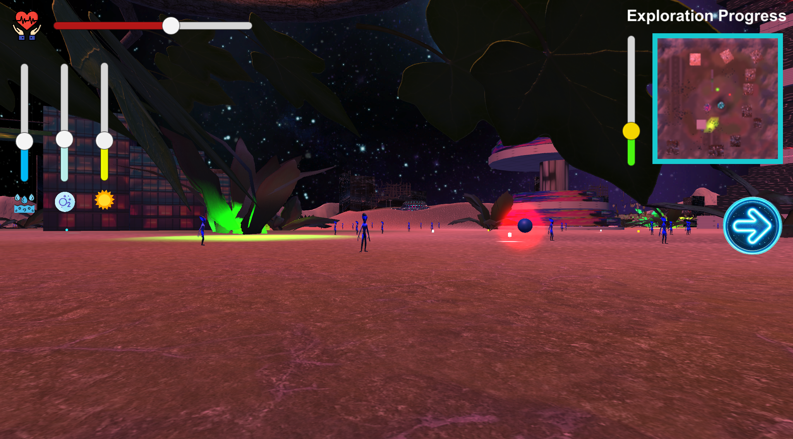
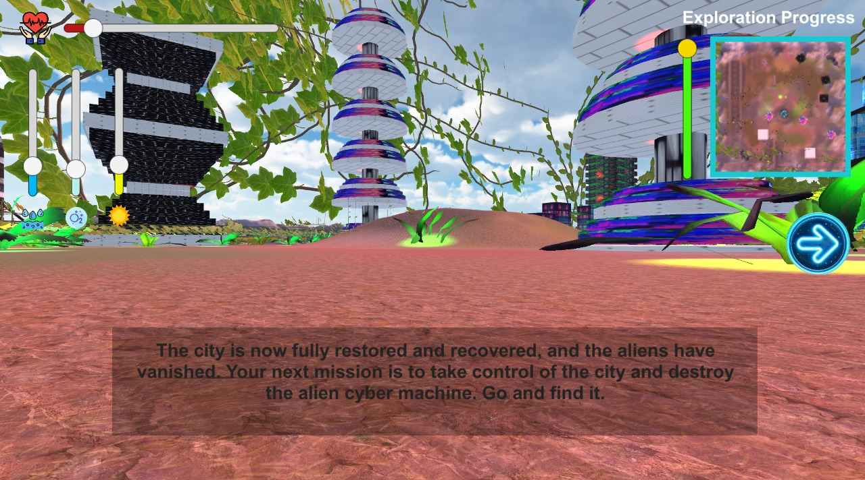
Before Restoration After Restoration
Once the restoration is completed, all that is left is to find the core of the enemy ship to hack it and disable it to achieve victory

